Slide 1

Teck Resources (TSX: Teck.B)

Slide 2



Presenters
Portfolio Manager | Analyst | Analyst | Analyst | Analyst
Lucas Schnull | Fahad Ahktar | Mebby Mengele | Aditya Advani | Roberto Rossi
Lucas is in his 3rd year of commerce at McMaster with a focus on Finance and Minor in Economics. He was previously an Analyst with the M&M and Macroeconomics sectors, and is also involved with the PEVC Association at DeGroote and ACIIC. In May he will be spending a year at Bank of America Securities in Global Equity Research. | Fahad is in his 4th year of commerce at McMaster, with a focus on Finance, and a Minor in Economics. He recently finished a one year Internship at Hydro One as a Business Analyst and is set to graduate in April 2019. He was previously involved with the McMaster Inter-Residence Council and the Career office as a CIP Ambassador. | Mebby is in his 2nd year of commerce at McMaster, with a focus on Finance and a Minor in Economics. He is currently an Analyst in the M&M Sector, an associate in the PEVC organization, and Chief Financial Officer of PhaseOne Engineering. He is currently working at TD Canada Trust in the retail banking sector. | Aditya is in his 2nd year of commerce at McMaster, and planning on going into finance. | Roberto is in his 2nd year of statistics at McMaster, while also focusing on finance and economics.

Slide 3









Company Overview
Company Snapshot
Revenue Breakdown – LT Favourable Markets
Teck Resources one of the worlds leading diversified mining companies
The company primarily produces metallurgical/coking (steelmaking coal) zinc and copper, with molybdenum, lead, and silver by-products
Recent production has begun in the Canadian oil sector and significant future developments are underway in the Chilean copper industry
Teck Resources was founded in 1962 and is headquartered in Canada
2019E Revenue
~$13.2B
2023E Revenue
~$14.1B
Stock Price $30.00 | Market Cap $17.3B | Enterprise Val $20.2B | Dividend Yield 0.70%
52 Week Range $24.80 - $38.25 | Shares Outstd. 563.3M | LTM Revenue $12,564M | Target Price $40.00
Geography Breakdown – Stable Geopolitics
Historical Growth – Strong Sales and Efficiency
Mine Locations
Diversified Buyers
Revenue (billions C$)
EBITDA (billions C$)
11% CAGR
31% CAGR
Company Overview
Industry Overview
Operations
Investment Theses
Financial Analysis
Risks & Catalysts
Conclusion

Slide 4
Further Analysis
2 Year Stock Chart
Operating Assets Summary
5
Segment | Primary Asset | Details
Steelmaking Coal | Elk Valley Mines | High quality steelmaking coal Long life Upper half of margin curve
Copper | Highland Valley, Antamina, Carmen de Andacollo | Long life Bottom half of cost curve Multiple growth opportunities
Zinc | Red Dog Trail (Smelter) | Long life Bottom quartile of cost curve Outstanding potential at Aktigiruq
Energy | Fort Hills | Long Life High quality low carbon intensity Low operating costs and expandable
Opportunities for expansion at key producing asset over the next few years
8
4
2
1
9
6
3
7
Key Events
Falling EV/EBITDA Despite Financial Performance
Date | Headline
Feb 21, 2019 | Teck Receives Investment Grade Rating from Fitch
Dec 20, 2018 | Teck Announces Investment in Sun Metals
Dec 4, 2018 | Teck Announces US $1.2B Quebrada Blanca Transaction
Aug 8, 2018 | Quebrada Blanca Phase 2 Receives Regulatory Approval
Jan 29, 2018 | Teck Announces First Oil at Fort Hills
Nov 16, 2017 | Teck Announces Dividend and Share Buyback
May 12, 2017 | Fortis and Teck Announce Waneta Dam Agreement
Apr 26, 2017 | Teck Doubles Dividend and Announces Dividend Policy
Feb 21, 2017 | Teck Announces Cash Tender Offers and Consent Solicitations
1
2
3
4
5
6
7
8
9
Company Overview
Industry Overview
Operations
Investment Theses
Financial Analysis
Risks & Catalysts
Conclusion

Slide 5
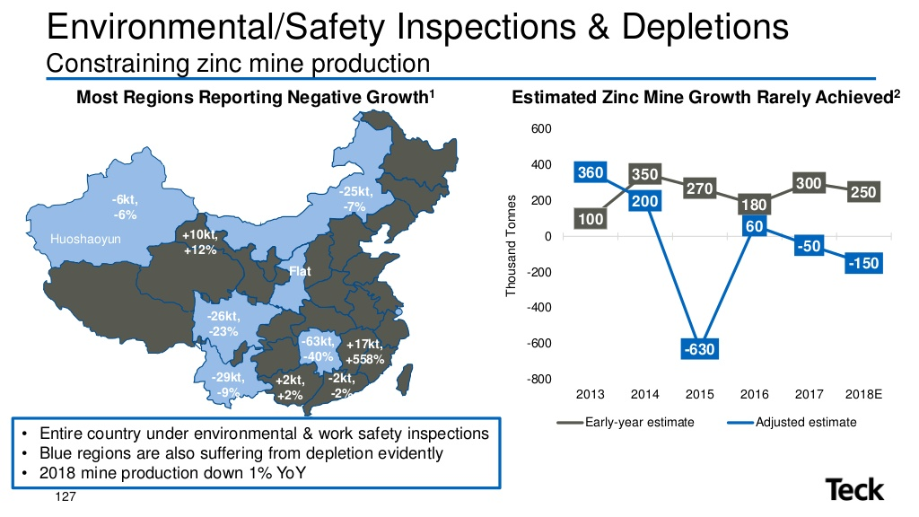
Industry Overview
Steelmaking Coal
Copper
Zinc
Subtitle
Company Overview
Industry Overview
Operations
Investment Theses
Financial Analysis
Risks & Catalysts
Conclusion

Slide 6





Commodity Outlooks
Coking Coal (US$/tonne)
LME Copper (US$/lb)
2016 | 2017 | 2018 | 2019 | 2020 | 2021 | 2022 | 2023
114 | 209 | 209 | 175 | 150 | 135 | 130 | 130
114 | 209 | 209 | 175 | 160 | 150 | 150 | 150
114 | 209 | 209 | 186 | 170 | 165 | 150 | 145
114 | 209 | 209 | 180 | 160 | 160 | 150 | 140
114 | 209 | 209 | 183 | 160 | 155 | 155 | 155
 |  |  | 180 | 160 | 153 | 147 | 144
2016 | 2017 | 2018 | 2019 | 2020 | 2021 | 2022 | 2023
2.21 | 2.80 | 2.96 | 2.75 | 2.85 | 3.15 | 3.35 | 3.45
2.21 | 2.80 | 2.96 | 3.00 | 3.20 | 3.50 | 3.75 | 3.75
2.21 | 2.80 | 2.96 | 3.05 | 3.25 | 3.15 | 3.25 | 3.40
2.21 | 2.80 | 2.96 | 2.63 | 3.00 | 3.25 | 3.50 | 3.50
2.21 | 2.80 | 2.96 | 3.25 | 3.51 | 3.13 | 3.18 | 3.20
 |  |  | 2.94 | 3.16 | 3.24 | 3.41 | 3.46
Upside
Recent supply constraints in Australia continue
Global demand increases
Downside
Oversupplied market coupled with lower economic growth
Australian supply recovers
Upside
Improved global growth and increasing inflation
Trade disputes resolved near-term
Downside
US-China tariffs and trade war persist, global GDP slowdown
China metal demand slows
LME Zinc (US$/lb)
WTI Crude Oil (US$/bbl)
2016 | 2017 | 2018 | 2019 | 2020 | 2021 | 2022 | 2023
0.95 | 1.31 | 1.33 | 1.29 | 1.35 | 1.30 | 1.28 | 1.30
0.95 | 1.31 | 1.33 | 1.20 | 1.20 | 1.15 | 1.10 | 1.05
0.95 | 1.31 | 1.33 | 1.23 | 1.20 | 1.15 | 1.10 | 1.10
0.95 | 1.31 | 1.33 | 1.30 | 1.30 | 1.25 | 1.25 | 1.20
0.95 | 1.31 | 1.33 | 1.15 | 1.08 | 1.02 | 1.12 | 1.10
 |  |  | 1.23 | 1.23 | 1.17 | 1.17 | 1.15
2016 | 2017 | 2018 | 2019 | 2020 | 2021 | 2022 | 2023
44 | 51 | 65 | 69 | 76 | 70 | 70 | 70
44 | 51 | 65 | 58 | 62 | 65 | 65 | 65
44 | 51 | 65 | 55 | 60 | 62 | 65 | 65
44 | 51 | 65 | 76 | 83 | 77 | 70 | 70
44 | 51 | 65 | 60 | 60 | 65 | 65 | 65
 |  |  | 64 | 68 | 68 | 68 | 67
Upside
Continued tightness in the zinc concentrate market
No additional restarts from Glencore
Downside
Trade war and slowing global GDP
Chinese zinc production expands more than expected
Upside
A
A
Downside
A
A
Teck produces commodities with strong supply-demand dynamics and low expected volatility, prices all above LT averages
Company Overview
Industry Overview
Operations
Investment Theses
Financial Analysis
Risks & Catalysts
Conclusion

Slide 7
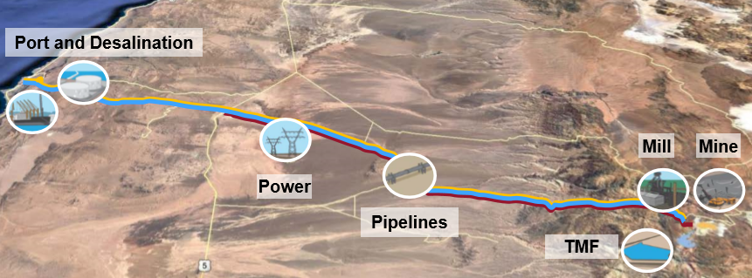
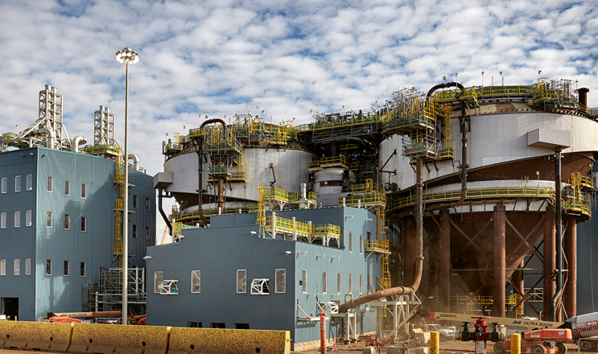
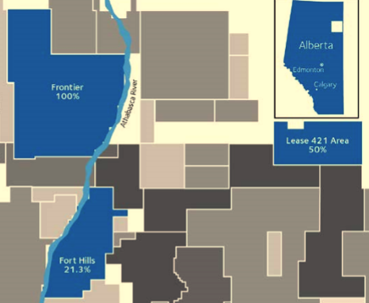
Production and Development
Operations – Growth and Optimization
Quebrada Blanca Phase 2
Segment | Strategy | Capital Allocation
Coking Coal | Maintain current production Optimize assets | Significant FCF even at lower prices Cash available to fund growth projects Neptune Terminals expansion
Copper | Build Quebrada Blanca 2 Optimize/extent mine life | Strong LT commodity fundamentals Attractive growth options (QB3, Zafranal, San Nicholas, NuevaUnion
Zinc | Maintain current production Optimize/extent mine life Define Aktigiruq potential | Strong near-term commodity outlook (significant FCF) Cash available to fund growth projects
Energy | Moving from cash outflow to inflow in 2019 | 2018-2019 ramp up Debottlenecking and expansion
Other Portfolio | Waneta Dam, NuevaUnion joint venture, Project Satellite
NPV
After-Tax @ 8%
US$2.4-4.2B
QB2 Prime Enhancement
QB3 Expansion
Production
First 5Y CuEq
316kt
Improving economics of QB2 with limited capital outlay
Expansion of operations to realize full potential of QB2
AISC
First 5Y (Net-Byproducts)
US$1.38/lb
Concentrator throughput, autonomous haulage, ore sorting, optimization
Vast deposit increase, double throughput, a top copper operation in the world
EBITDA
First 5Y
US$1.1-1.4B
Fort Hills – Premier Asset
Other Notable Projects
Life > 45 Years
Very Low Decline Rate
P&P Reserves 573Mbbl
Highland Valley
Antamina
38,000 bbl/d @ 21%
Cash Cost Target < $20/b
A
Advancing mine life extension Pre-Feasibility Study (targeting minimum of 15 years)
Mine life extension studies in progress
Completion of new D3 Ball Mill set for 2019, should improve recovery rates
Zinc Up 50%
Capturing value from Shovel-Based Ore Sorting, Autonomous Hauling, and Blast Movement Monitoring
Elkview Valley
Trail Operations
Water Strategy
Port Upgrades
20,000m²/d
AWTF
Operating
$310M
Frontier – Regulatory Phase
Lease 421 – Future Growth Opportunity
Capital
$22
#1 Acid Plant
#2 Acid Plant
20,000m²/d
SFR
Teck 100%: 3.2 billion barrels
Teck 50%: high grades & recovery, low fines
Operating
$50M
Capital
$10
Potential Pend Oreille life extension
Key financial and operational momentum building that could spur revaluation in the near-term
Company Overview
Industry Overview
Operations
Investment Theses
Financial Analysis
Risks & Catalysts
Conclusion

Slide 8
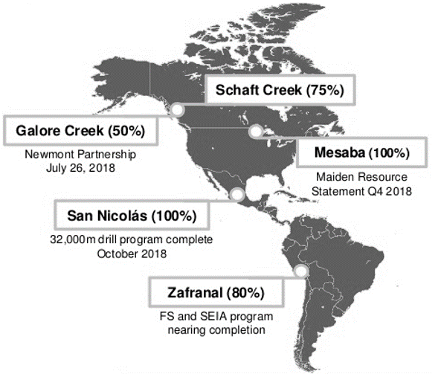
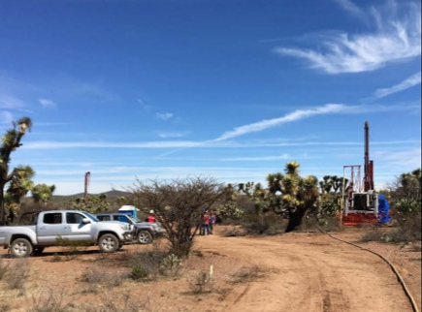
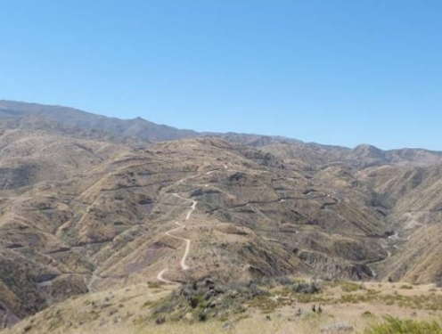
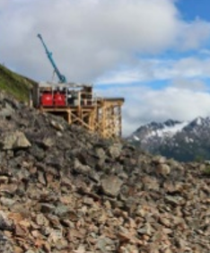
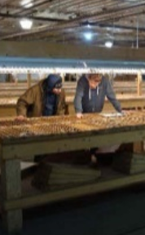
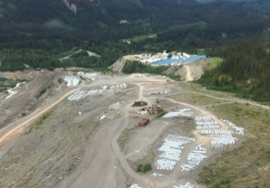
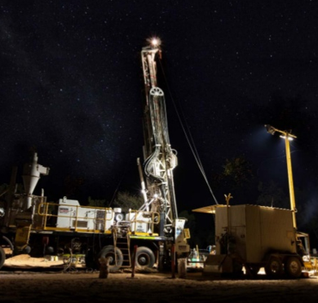
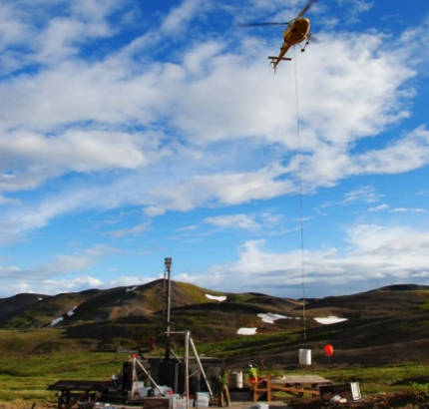
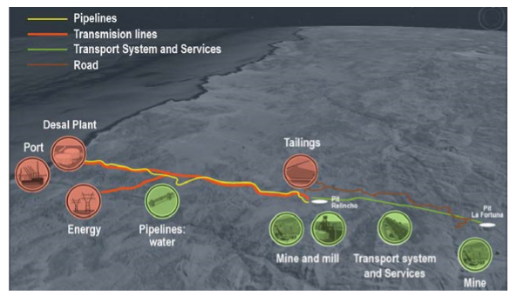
Exploration Projects
Copper
San Nicholas (100%)
 | Indicated | Inferred
Tonnes (Mt) | 91.7 | 10.8
Cu (%) | 1.24 | 1.24
Zn (%) | 1.70 | 1.00
Au (g/t) | 0.46 | 0.26
Ag (g/t) | 26.7 | 17.4
Zafranal (80%)
 | M & I | Inferred
Tonnes (Mt) | 467 | 21.4
Cu (%) | 0.38 | 0.24
Au (g/t) | 0.07 | 0.06
Cu (Mlb) | 3,925 | 114
Au (Moz) | 1.051 | 0.041
Project Satellite
Mesaba (100%)
Galore Creek (50%)
 | P & P | M & I
Tonnes (Mt) | 528 | 287
Cu (%) | 0.61 | 0.30
Au (g/t) | 0.52 | 0.33
Cu (Mlb) | 6,798 | 2,071
Au (Moz) | 5,435 | 2561
Significant Cu-Ni (Au-Ag-Cu) deposit (w/ Maiden Resource statement)
Evaluating partnership opportunities
Schaft Creek (75%)
Large Cu-Mo-Au-Ag deposit
Received multi-Year Area Based permit to carry out field studies
Fort Hills – Premier Asset
Copper-Gold Joint Venture
Teena (100%)
Aktigiruq (100%)
NuevaUnion (50%)
Greenfield Discovery
Brownfield Discovery
Combination of Teck’s Relincho and Goldcorp’s El Morro projects
Pre-Feasibility Study Parameters
Mine Life | 36 Years
Au (Concentrate Contained) | 5.9M oz
Cu (Concentrate Contained) | 15.7B lb
Gold Grade | 0.48 g/t
Copper Grade | 0.40%
Strip Ratio | 1.70 : 1
C1 Costs (First 5 Years) | $0.71/lb Cu
Initial Capital | ~$3.45B
Enhancement Capital | ~$3.65B
Sustaining Capital | ~$2.15B
Value Realization
Value Realization
One of the largest undeveloped copper-gold-molybdenum projects the Americas
2013: Discovery
2016: Consolidated 100% ownership
Next 18 Months: advancing delineation
2001: Initial drill hole
2017: Exploration target announced
Next 18 Months: advancing delineation
Phased Development Approach
Relincho
(104ktpd)
La Fortuna (116 ktpd)
Relincho
(208 ktpd)
Details
Details
Inferred
58 Mt
Zn: 11.1%
PB: 1.5%
Most significant Zn-Pb discovery in Australia since 1990
Exploration Target
80-150 Mt
Zn + Pb: 16-18%
Operating history, only 12km away from Red Dog mine site
Concentration in high quality and stable copper assets should be ascribed significant value
Company Overview
Industry Overview
Operations
Investment Theses
Financial Analysis
Risks & Catalysts
Conclusion

Slide 9
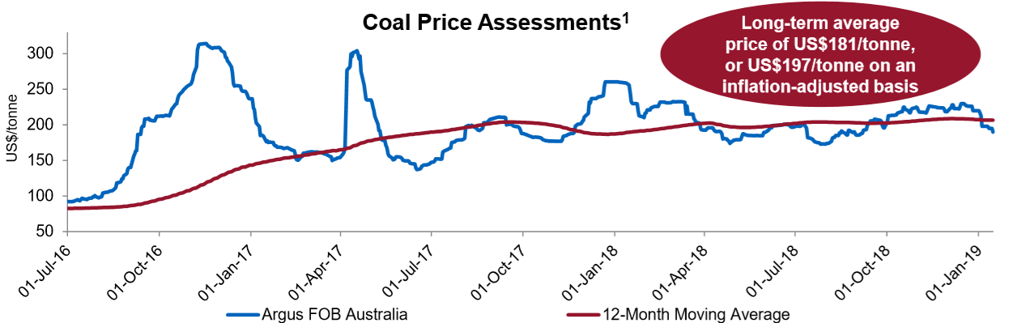
Investment Thesis I – Internal and External Defensibility
Capital Structure Management – Target 30% D/E
Overly Bearish Zinc Sentiment
Significant Debt Reductions
Investment Grade Ratings
Down 43%
Moody’s
January 16, 2019
Fitch
February 21, 2019
???
Further upgrade potential
Flexible Maturity Profile (US$M)
Teck vs Peers Share Dilution
Past and Present Security
Right Commodities at Right Time
Teck Resources During
2012 – 2016 Downturn
Well Positioned for Future “Green” Economy
Steelmaking Coal
Secular demand growth in India and SE Asia
$300/t
$250/t
No Equity Issued
GHG Emission Intensity (kgCO₂e/tonne)
China capacity reductions, controls, and checks
$200/t
$150/t
Invested in Production Growth
at Fort Hills
Copper
10
Coal
200
Forward curve > US$165/t through 2021
$100t
$50/t
Jan 17
Jan 18
Jul 18
Jul 16
Jul 17
Jan 19
Copper
Zinc
No Core Assets Sold
Mine production to peak in 2022 and structural deficit to emerge
Structural deficit to ease in 2020 and remerge in 2022, record low inventories
33% Debt Reduction and
Maturities Managed
5
100
Teck is in the bottom quartile
of miners
Mt Contained
Only ~ 5%
000’ Tonnes
Maintained Liquidity
(Currently ~$7B)
0
0
Over the past few years Teck has taken prophylactic measures to weather any economic or political headwinds
Company Overview
Industry Overview
Operations
Investment Theses
Financial Analysis
Risks & Catalysts
Conclusion

Slide 10
Investment Thesis II – Project Pipeline
Top World Zinc Producer and Growing
Copper Growth Potential
Production Profile
Peer Rankings (000’ tonnes)
~790
Zafranal
San Nic
Teck Potential #6 (680)
Teck Current #15 (274)
Contained Zn+PB (Mt)
Nueva U
~313
QB2
Coal Profit Maximization
EBITDA Potential
Action Taken
Result
Multiple Normalization
Quebrada Blanca 2
Energy Business
$14M – Intersite Coal Hauling (Elkview)
$53M in FCF
Current Teck
EV/EBITDA Multiple
3.8x
EBITDA potential of ~US$635 million at 60% ownership assuming LT copper price of US$3.00/lb
EBITDA potential at full production of ~C$500 million at US$75/bbl WTI and US$15/bbl WTI-WCS differential
$7M – Contract Mining
(Line Creek)
$59M in FCF
Historical Teck EV/EBITDA Multiple
5.8x - 6.7x
$1M – PIP Engagement
(Greenhills)
$17M in FCF
Future realized EBITDA likely much higher
due to LT copper prices, reserve development, and QB3 expansion
Resource upside at Frontier and Lease 421
Current Peer
EV/EBITDA Multiple
6.5x - 7.5x
63kt – Hauling to Fording
(Greenhills)
$7M in FCF
Historical energy EV/EBTIDA of 8x-10x
Total of $135 Million in Additional Free Cash Flow Generated
Teck’s TTM EBITDA ~$10.00/share
EBITDA Potential
~$1.50/share
EBITDA Potential
~$1.00/share
Teck Resources’ reputation as a coal producer is obscuring upcoming base metal opportunities, LT value to be unlocked
Company Overview
Industry Overview
Operations
Investment Theses
Financial Analysis
Risks & Catalysts
Conclusion

Slide 11
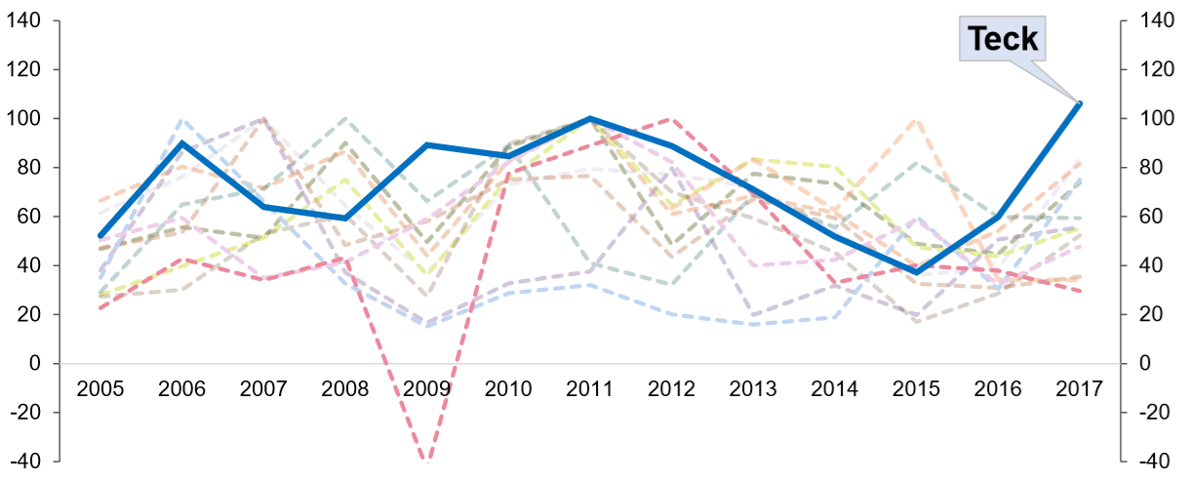
Comparables Analysis
Public Comparable Analysis
Teck EV/EBITDA vs Pure-Play Copper & Coal Peers
Leading Operating FCF Yield
Teck trades well below copper, and even coal peers, despite a diversified base with copper expansion.
4x
Peer group includes: Freeport-McMoRan, Hudbay Minerals, Glencore, Lundin Mining, First Quantum Minerals, Barrick Gold, Goldcorp, Anglo American, Vale SA, BHP Billiton, Rio Tinto, and Southern Copper
Teck should trade at a higher multiple given diversified production base and leading FCF Yield and EBITDA Margins
Company Overview
Industry Overview
Operations
Investment Theses
Financial Analysis
Risks & Catalysts
Conclusion

Slide 12
NAV Model
Net Asset Value Analysis
Given the NAV model base case assumptions Teck Resources is trading at a ~XX% discount to its intrinsic value
Company Overview
Industry Overview
Operations
Investment Theses
Financial Analysis
Risks & Catalysts
Conclusion

Slide 13
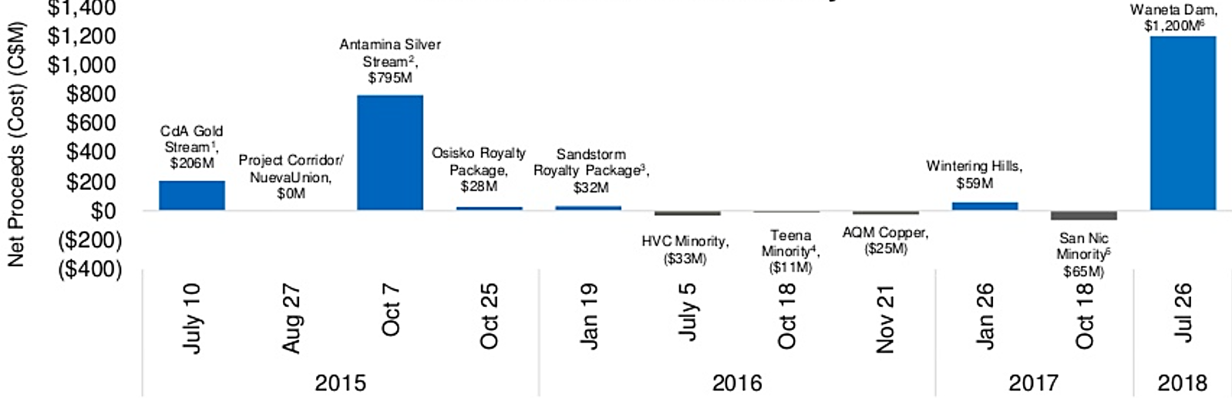

Risks & Catalysts
Risks
Risk | Probability | Analysis
Commodity Prices and FX |  | Greater-than-expected downward pressure on coal, copper, and zinc prices, exchange rate volatility Improvement in commodity prices above forecasts would also serve a catalysts
Chinese Uncertainty |  | An unexpected slowdown in global economic growth (and China in particular) is a key risk all mining companies are highly leveraged to
Fort Hills Impairments |  | Unsuccessful ramp-up of the Fort Hills oil project, including delayed timelines and below-forecast production volume
Catalysts
Catalyst | Probability | Analysis
Elk Valley Water Management |  | If Teck is successful in permitting saturated rock fill (SRF) projects, it expects that its previous capex guidance for water management between 2018-2022 to be reduced (~$300M)
Project Updates (Next 12 Months) |  | Feasibility Studies – Zafranal (1H19), NuevaUnion (2H19), San Nicholas (Pre 2H19) Quebrada Blanca Phase 2 Development
Fort Hills Positive EBITDA |  | The Fort Hills oil project is expected to generate positive EBITDA in 1Q19 Expected to reach 92.7% uptime and total capacity of 194,000bpd
Mill Upgrades |  | Red Dog – mill upgrade start-up in 1Q20 Highland Valley – ball mill upgrade complete 3Q19
Copper Growth Strategy
Diversification
Recent Transaction Analysis
QB2 Expansion
No single country (buyer) accounts
for > 20% of Teck’s revenue
Expansion into copper and energy
Current Projected
Mines and projects located in Canada, USA, Chile, and Peru
Catalysts well outweigh risks, majority of risks are non-systematic, and Teck is well diversified to mitigate
Company Overview
Industry Overview
Operations
Investment Theses
Financial Analysis
Risks & Catalysts
Conclusion

Slide 14











Conclusion
Investment Summary – Compelling Value
Financial Analysis Target Price
Strong
Execution
Premier operating assets, proven track record, and profitability enhancement at all operations
NAV | 6%
Solid Financial
Position
Significant liquidity and strong cashflow with a stable dividend and history of buybacks
NAV | 8%
NAV | 10%
Disciplined
Capital Allocation
Long-term balanced approach of cash returns to share- holders, capital spending, balance sheet management
EBITDA | 4.5x
Robust Project
Pipeline
Long-term stability, mid-term production growth, and short-term catalyst opportunities
EBITDA | 5.5x
Higher Multiple Justification
Despite Teck’s diversified production base and financial footing it is trading ~3x below peers
Blended NAV & EBITDA
Share Structure and Holders
Street Target Prices
Class A Shares ~7.8M
Class B Shares ~563.3M
Current Price ($29.0)
Avg Target ($38.4)
Temagami Mining Company
Institutions
SSM Resources (Sumitomo)
General Public
Sovereign Wealth
Other
Other
Total
Total
Considering all the factors throughout this presentation Teck Resources is a buy with a PT of XX (+XX%)
Company Overview
Industry Overview
Operations
Investment Theses
Financial Analysis
Risks & Catalysts
Conclusion

Slide 15
Appendices

Slide 16
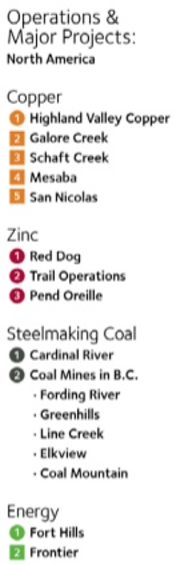
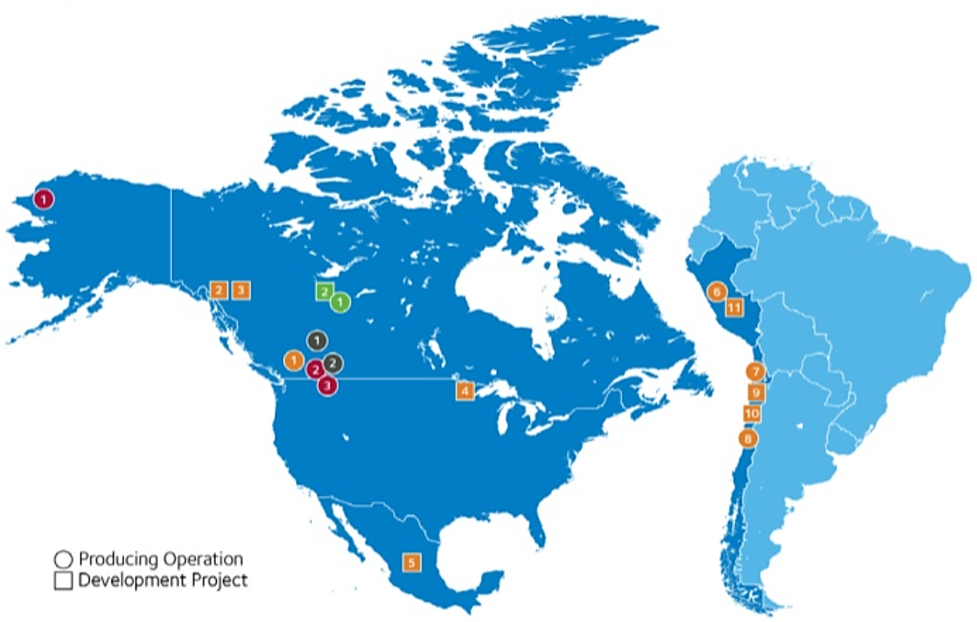
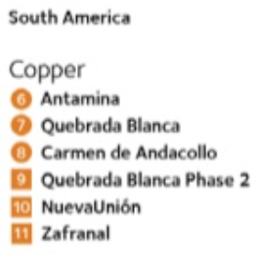
Global Asset Map

Slide 17
Reserves and Resources
Copper, Zinc and Metallurgical Coal
Oil and Gas
Observations

Slide 18
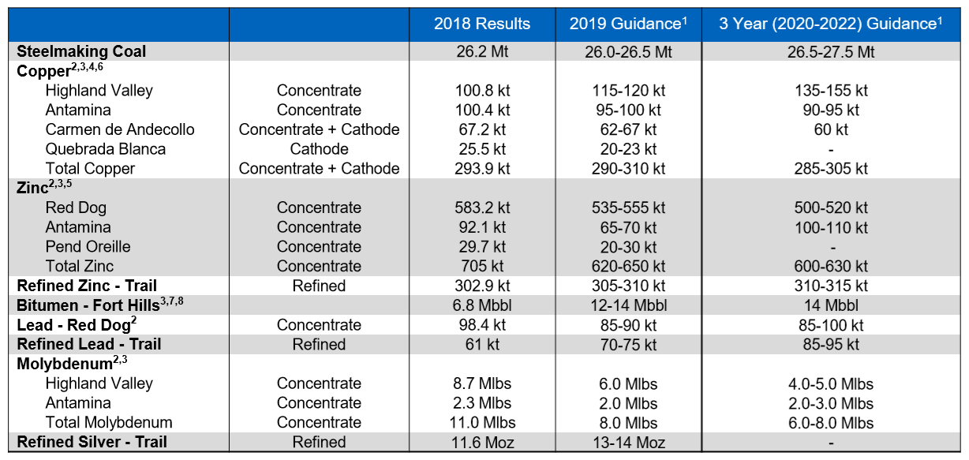
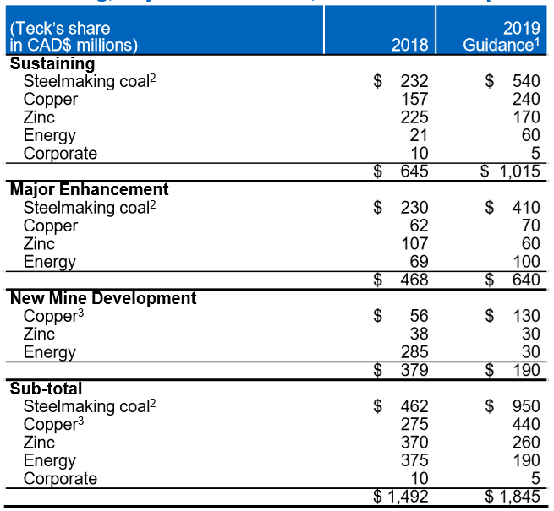
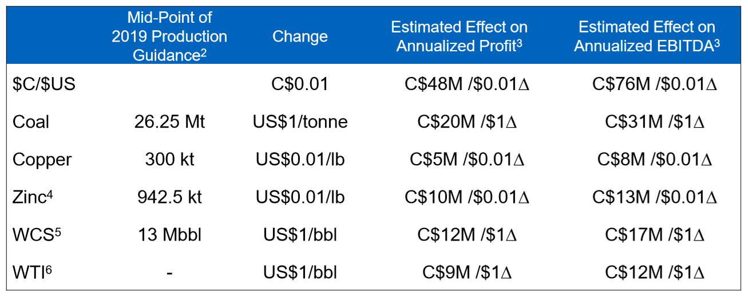
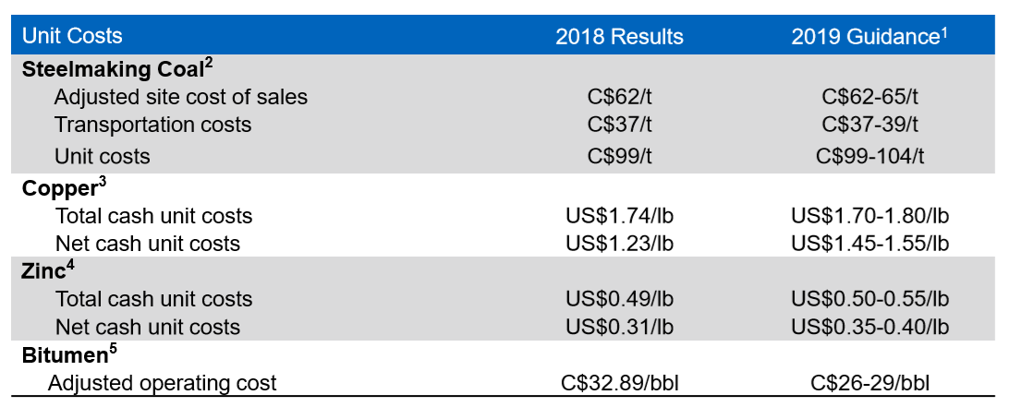
Production Guidance

Slide 19
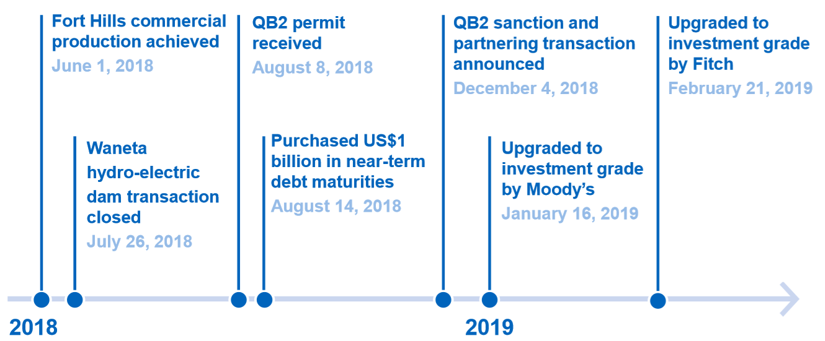
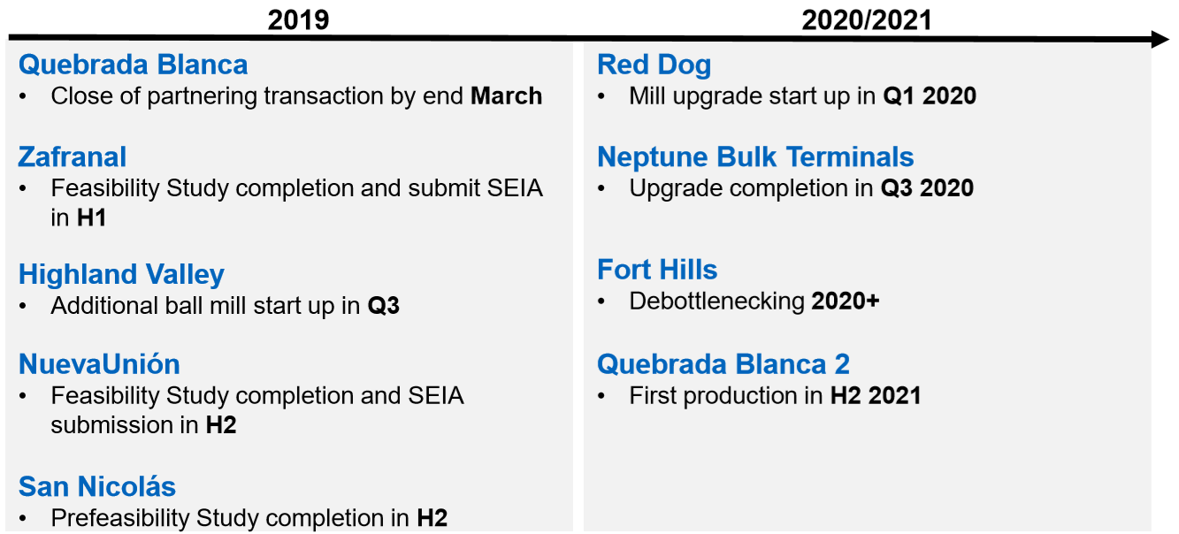
Milestones
Recent
Future

Slide 20
Project Pipeline Breakdown
 | In Construction | Mid-Term Growth Options | Future Options
Copper Strong platform with substantial growth options | Quebrada Blanca 2 | QB3 | Galore Creek
 | HVC D3 Project | Zafranal | Schaft Creek
 |  | HVC Brownfield | Mesaba
 |  | NuevaUnion
 |  | San Nicholas (Cu-Zn)
Zinc Premier resource with integrates assets | Trail #2 Acid Plant | Antamina Brownfield (Cu-Zn) | Teena
 | Red Dog VIP2 Project | Red Dog Satellite Deposits | Cirque
Coal Well established with capital efficient value options | Elk Valley Replacement Brownfield |  | Quintette/Mt. Duke
 | Neptune Terminals Expansion |  | Coal Mountain 2
 |  |  | Elk Valley Brownfield
Energy Building a new business through partnership |  | Fort Hills Debottlenecking & Expansion | Frontier
 |  |  | Lease 421

Slide 21
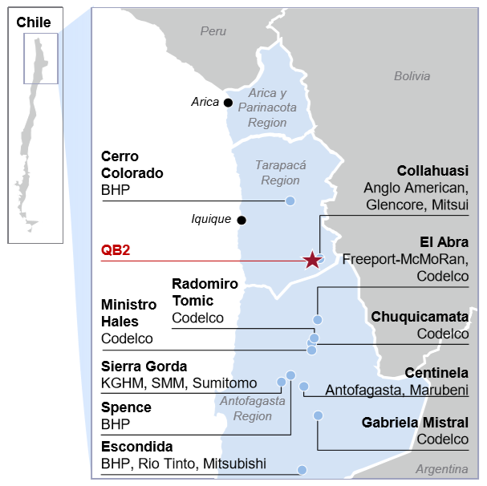
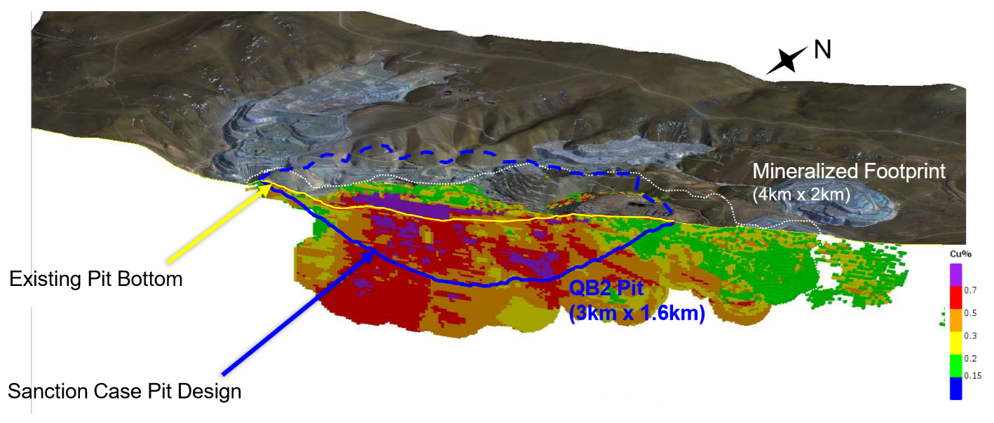
Quebrada Blanca Analysis
Project Highlights
Vast, long life deposit
Top 20 producer with top 5 potential through QB3
Very low strip ratio
Low all-in sustaining costs
Enhancement (QB2 Prime) and expansion potential (QB3)
Competitive capital intensity
High grade, clean concentrates
Permitted with engineering ~80% complete and construction ready
Community agreements in place and strong local relationships

Slide 22
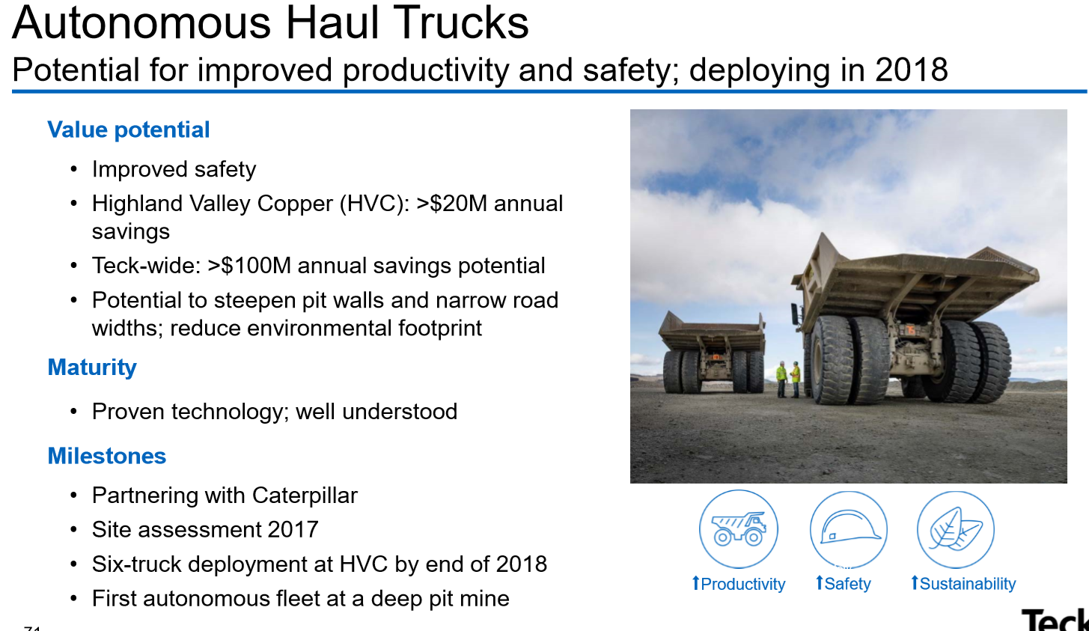
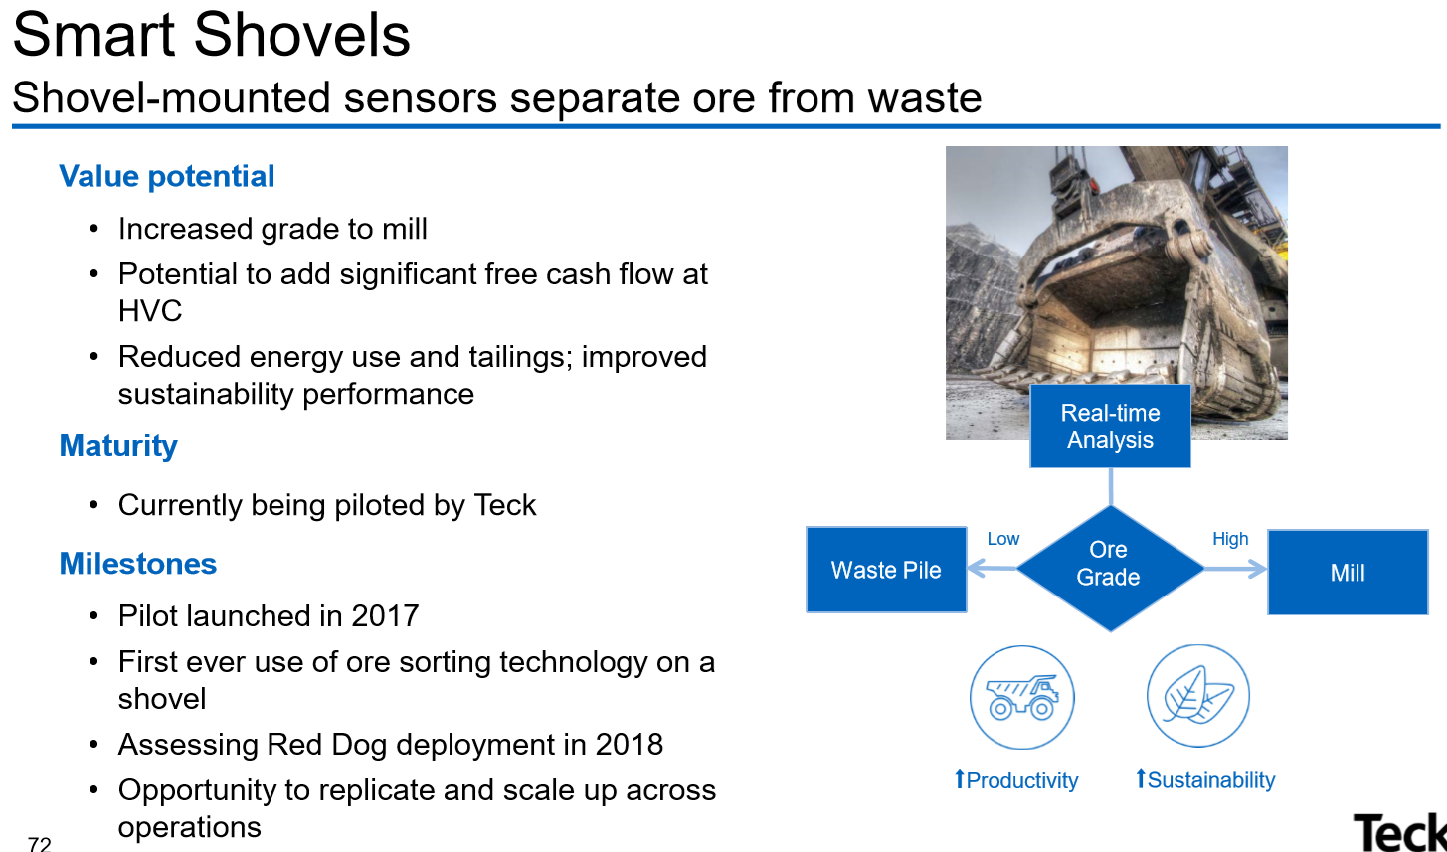
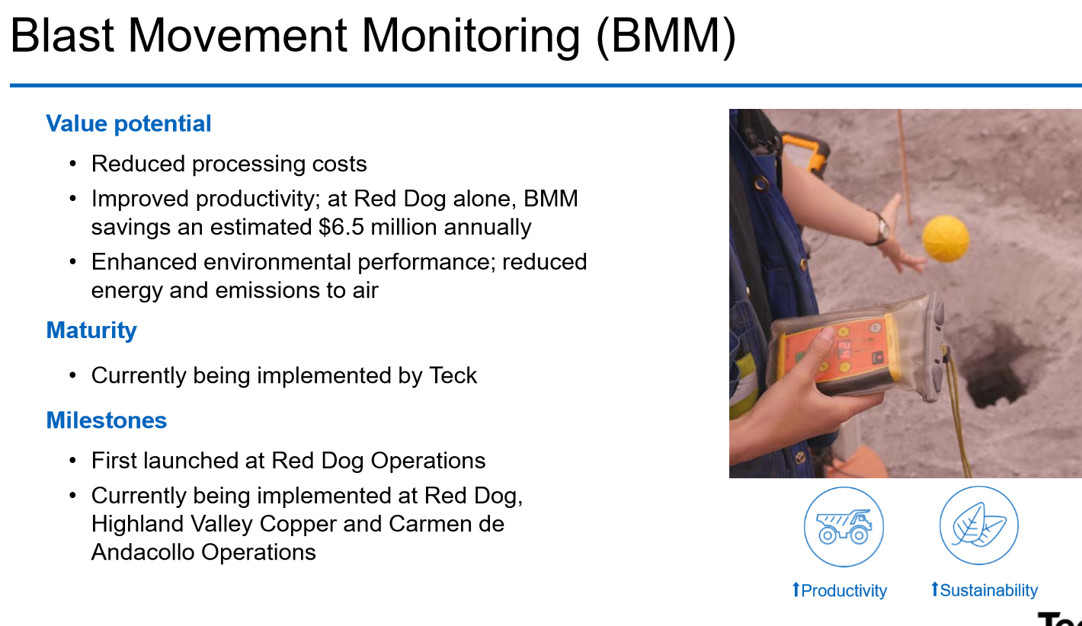
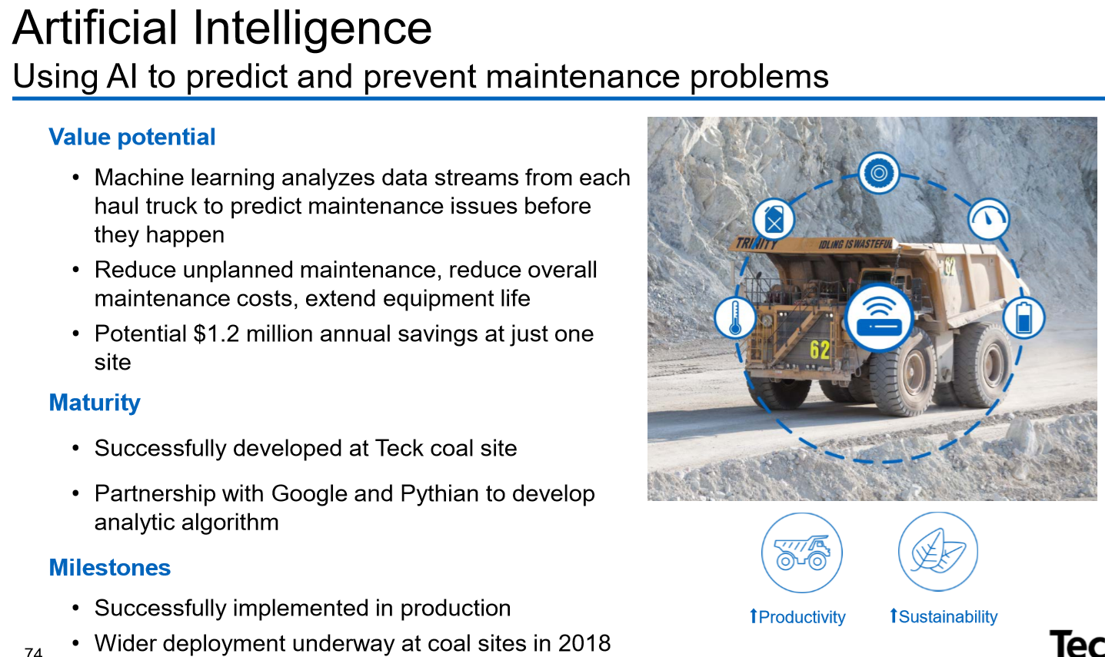
Innovation Focus

Slide 23
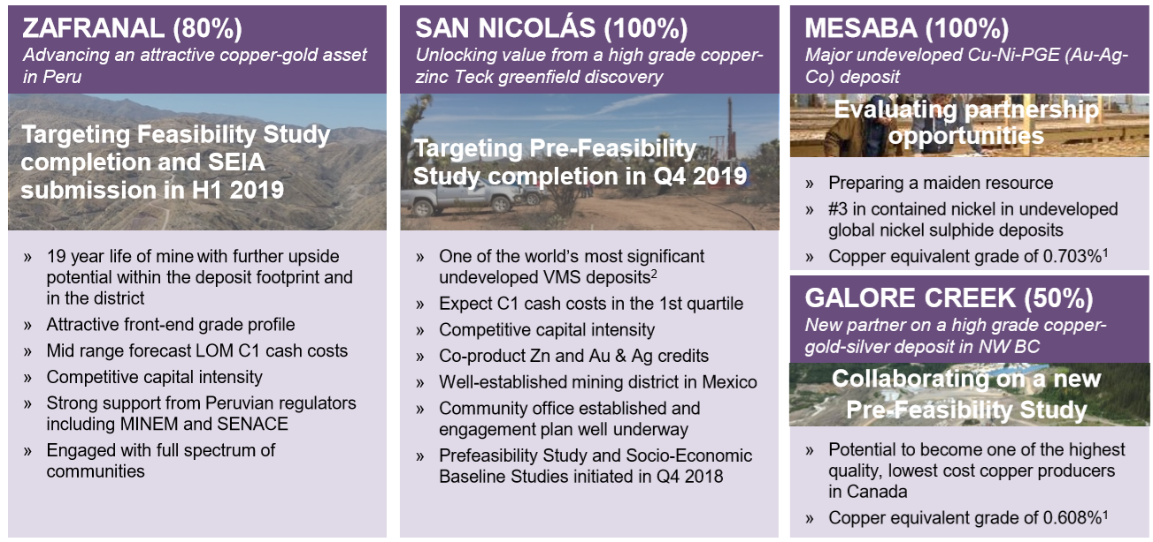
Project Satellite Details

Slide 24
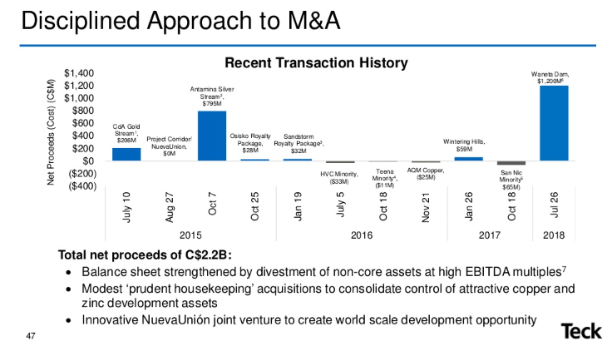
Precedent Transactions
November 2016
Teck acquires all issued and outstanding shares of AQM copper for approximately $25M CAD
Provides Teck with more indirect interest in the Zafranal copper-gold project
May 2017
Fortis purchases Teck’s two-thirds interest in the Waneta Dam and related transmission assets in British Columbia, Canada, for $1.2 billion cash.
Strengthens Teck’s balance sheet and provides significant new capital for reinvestment
June 2017
Teck purchases 21% interest in Goldcorp’s San Nicolás Copper-Zinc Project
Purchased for $50M, Teck will now own 100% of the project
April 2018
Teck acquires additional 13.5% interest Compañia Minera Teck Quebrada Blanca S.A. (“QBSA”), bringing total interest to 90%
High quality copper development project in Northern Chile with low risk and expected long-life. Will substantially increase Teck’s copper production
One of the world’s largest undeveloped copper resources, mine life of 28 years
December 2018
Teck acquires 12.5M shares for 13.8% of Sun Metals for $3.5M
Mineral exploration company with project in British Columbia
Purchased for investment purchases, may increase/decrease investment depending on market conditions
December 2018
Teck sells 30% interest in QBSA to Sumitomo Metal Mining for $1.2B
Reduces Teck’s estimated remaining share of equity contributions
Delays Teck’s expected cash contribution to 2020

Slide 25
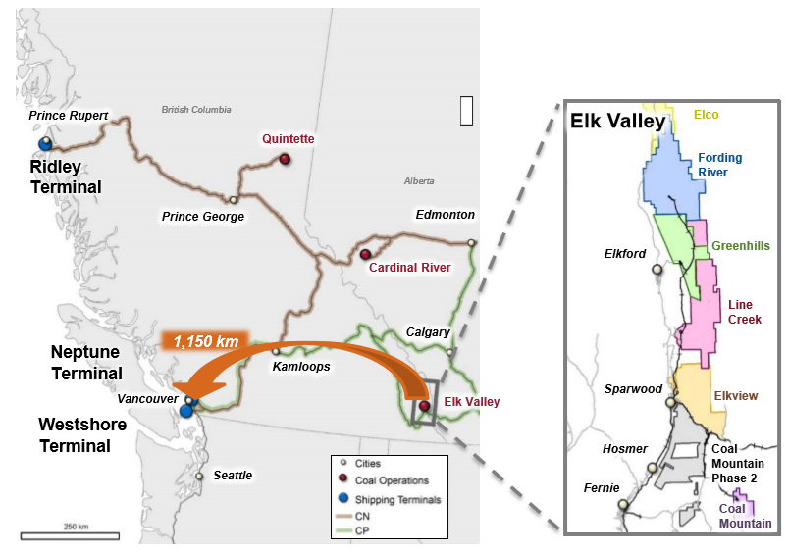
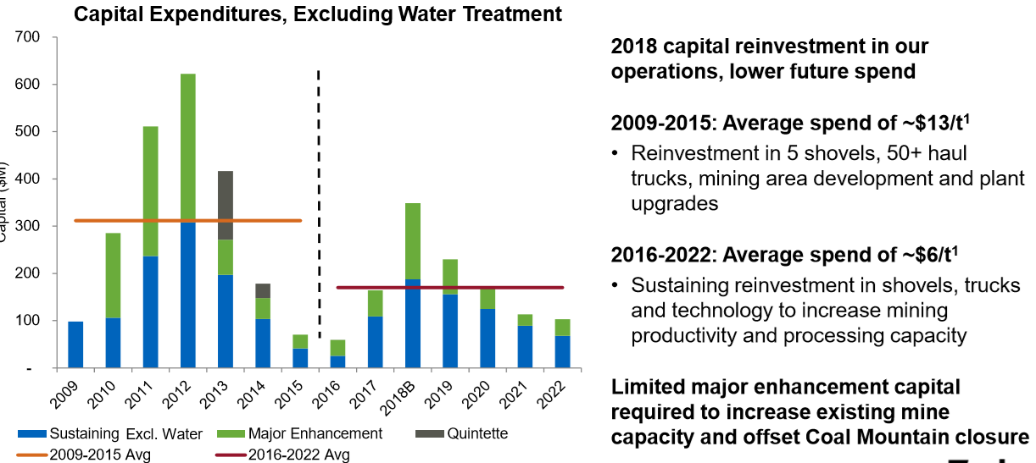
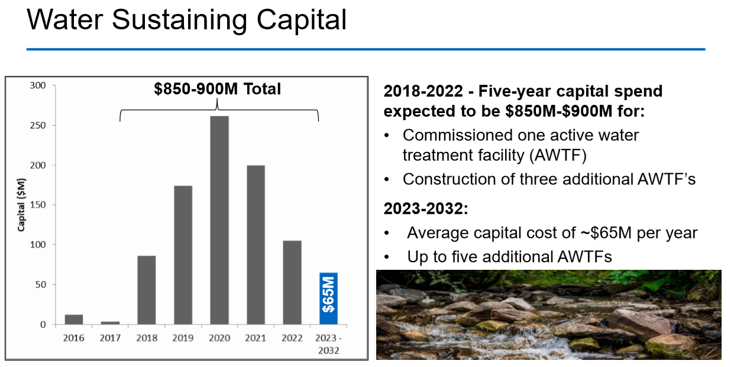
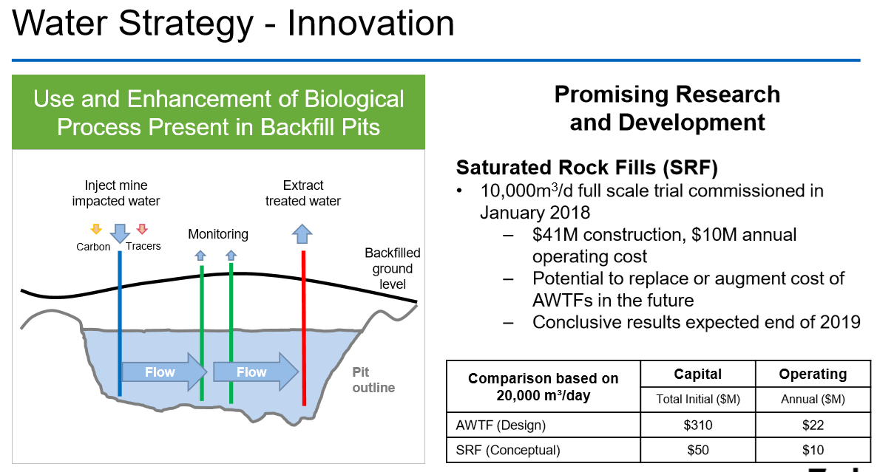
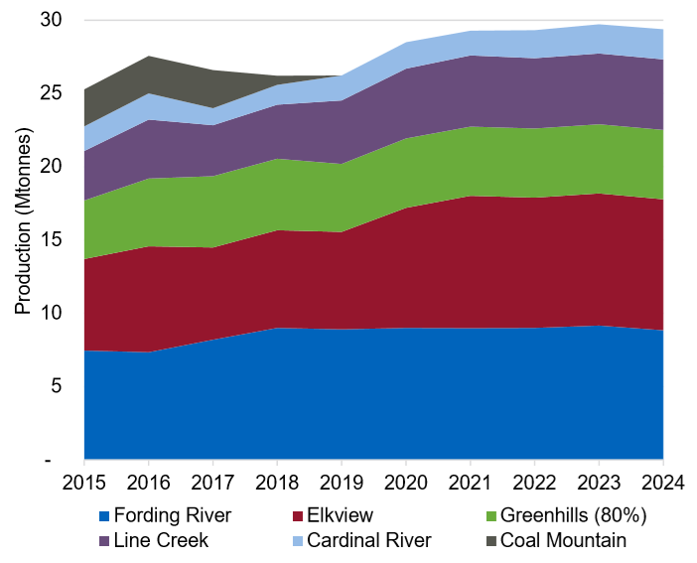
Coal Business

Slide 26




Management Overview
President & CEO | SVP Exploration & Projects | SVP Energy | SVP Finance & CFO
Donald Lindsay | Alex Christopher | Kieron McFadyen | Ronald Millos
Description Appointed CEO in 2005 Harvard Business School MBA Head of Investment and Corporate Banking at CIBC until 2004 | Description Joined Teck Resources in 1984 B.Sc. in Geology from McMaster University Professional geoscientist and on the board of PDAC | Description B.Sc. in Mechanical Engineering 30 years of operational experience in large-scale energy assets Executive VP of Cenovus Energy previously | Description Joined Teck in 1995 and was appointed CFO in 2005 B.Sc. In Geology from McMaster University CPA holder and Commerce degree from UBC
Compensation Options - $2,973,000 PSU - $2,974,200 | Compensation N/A | Compensation N/A | Compensation Options - $780,100 PSU - 775,200

Slide 27
Consolidated Income Statement

Slide 28
Consolidated Cash Flow Statement

Slide 29
Consolidated Balance Sheet

